Slide 1
Chapter 6 More About Loops and Decisions

Slide 2
6.1 Combining Loops With If-Then Statements
By combining loops and decision structures, programs become much more complex.
Loops can be nested inside selection structures and selections can be nested inside loops.
Loops can be nested inside other loops.
Using multiple combinations of these structures allows for limitless possibilities!

Slide 3
Exiting a Loop Early
One reason to nest a selection structure inside a loop is to allow the loop to end before the test condition has been met for any reason. For example:
If the user has entered an incorrect value that would cause an error
If the user has entered a required response and the program can continue without further iterations

Slide 4
Example: Exiting the Loop When There’s No More Money
1 Declare Cost, Total, Max As Float
2 Declare Count As Integer
3 Set Total = 0
4 Write “Enter the maximum amount you want to spend: $ “
5 Input Max
6 For (Count = 1; Count < 11; Count++)
7 Write “Enter the cost of an item: “
8 Input Cost
9 Set Total = Total + Cost
10 If Total > Max Then
11 Write “You have reached your spending limit.”
12 Write “You cannot buy this item or anything else.”
13 Set Total = Total – Cost
14 Exit For
15 End If
16 Write “You have bought “ + Count + “ items.”
17 End For
18 Write “Your total cost is $ “ + Total

Slide 5
Example: The Guessing Game using a Do…While loop
1 Declare SecretNumber, Count, Guess As Integer
2 Write “Enter a secret number: “
3 Input SecretNumber
4 Clear Screen
5 Set Count = 1
6 Do
7 Write “Guess the secret number: “
8 Input Guess
9 If Guess == SecretNumber Then
10 Write “You guessed it!”
11 Exit Loop
12 Else
13 Write “Try again”
14 End If
15 Set Count = Count + 1
16 While Count <= 5

Slide 6
Example: Combining Loops, Decisions, and Validating Data Computing valid square roots
1 Declare Number, Root As Float
2 Declare Response As Character
3 Write “Do you want to find the square root of a number?”
4 Write “Enter ‘y’ for yes, ‘n’ for no: “
5 While Response == “y”
6 Write “Enter a positive number: “
7 Input Number
8 If (Number >= 0) Then
9 Set Root = Sqrt(Number)
10 Write “The square root of “ + Number + “ is: “ + Root
11 Else
12 Write “Your number is invalid.”
13 End If
14 Write “Do you want to do this again?”
15 Write “Enter ‘y’ for yes, ‘n’ for no: “
16 Input Response
17 End While

Slide 7
6.2 Combining Loops and Decisions in Longer Programs
The example in the next slide shows how to keep track of how many positive numbers and how many negative numbers are input by a user.
Uses for this type of program:
Embed in a larger program to track various types of entries
Use by a college to enter demographic information on students
Use by a business to track number of items purchased that were above or below a certain cost

Slide 8
Example: Keeping Track of User Input
1 Declare PositiveCount, NegativeCount, Number As Integer
2 Set PositiveCount = 0
3 Set NegativeCount = 0
4 Write “Enter a number. Enter 0 when done: “
5 Input Number
6 While Number != 0
7 If Number > 0 Then
8 Set PositiveCount = PositiveCount + 1
9 Else
10 Set NegativeCount = NegativeCount + 1
11 End If
12 Write “Enter a number. Enter 0 when done: “
13 Input Number
14 End While
15 Write “Positive numbers entered: “ + PositiveCount
16 Write “Negative numbers entered: “ + NegativeCount

Slide 9
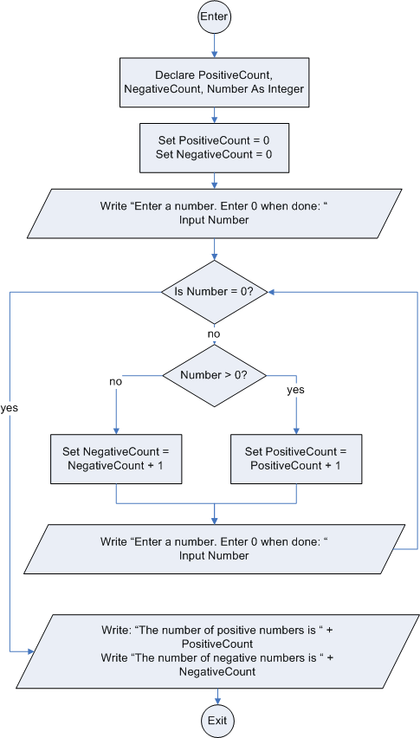
Flowchart using a selection structure with a loop to keep track of the number of positive and negative numbers entered

Slide 10
The Length_Of() Function
The Length_Of() function takes a string or a string variable inside the parentheses and returns the number of characters in that string.
MyLength = Length_Of(“Hello”) assigns the value of 5 to MyLength because ”Hello” has five characters.
MyLength = Length_Of(“Good-bye!”) assigns the value of 9 to MyLength because the string has nine characters, including the hyphen and exclamation point.
If Name = “Hermione Hatfield” then:
MyLength = Length_Of(Name) assigns the value of 17 to MyLength.
If TheSpace = “ “ then:
MyLength = Length_Of(TheSpace) assigns the value of 1 to MyLength because a space counts as one character.

Slide 11
The Print Statement and the newline Indicator <NL>
The Write statement indicates output to the screen with the assumption that each new Write statement would begin on a new line.
The Print statement indicates output to the screen, including the ability to concatenate variables and text. However, until the newline indicator is used, it is assumed that output from any subsequent Print statements will be on the same line. The newline indicator is <NL>.
Code | Code
Write “Hi” Write “Ho” Write “Done” | Print “Hi” Print “Ho” <NL> Print “Done”
Display | Display
Hi Ho Done | HiHo Done

Slide 12
Using the Length_Of() Function for Formatting
1 Declare Name As String
2 Declare Symbol, Choice As Character
3 Declare Number, Count As Integer
4 Set Count = 0
5 Write “Enter your name: “
6 Input Name
7 Write “Choose one of the following symbols: * or # “
8 Input Symbol
9 Write “Do you want a space between each symbol? Enter ‘Y’ for yes, ‘N’ for no”
10 Input Choice
11 Set Number = Length_Of(Name)
12 Print Name <NL>
13 While Count <= Number
14 If Choice == “y” OR Choice == “Y” Then
15 Print Symbol + “ “
16 Set Count = Count + 2
17 Else
18 Print Symbol
19 Set Count = Count + 1
20 End If
21 End While

Slide 13
6.3 Random Numbers
Random numbers are numbers whose values form an unpredictable sequence.
They have many interesting applications in programming.
One major use is to provide an element of chance in computer games.
They are also used to simulate situations or processes in business, mathematics, engineering, and other disciplines.

Slide 14
The Random() Function
Most programming languages contain a function that is used to generate a sequence of random numbers.
The name of this function and the way it works varies from language to language.
We define a function of the following form: Random() which generates a random number from 0.0 to 1.0 (including 0.0 but not 1.0).
To increase the range of random numbers generated, multiply Random() by any value.
To change the spread of the range, add an integer to the values generated.
Use the Int() or Floor() function to generate random integers.

Slide 15
Examples of Random Numbers Using the Random()Function
If Random() = 0.3792, then Random() * 10 = 3.7920
If Random() = 0.0578, then Random() * 10 = 0.5780
Multiplying Random() by 10 generates random numbers between 0.0 and 10.0, not including 10.0.
To generate only integer values, use the Floor() or Int() function:
If Random() = 0.3792, then Floor(Random() * 10) = 3
If Random() = 0.0578, then Floor(Random() * 10) = 0
To change the range of integers, add a number to the result. For example, adding 1 to the previous result will generate random numbers between 1 and 10.
If Random() = 0.3792, then (Floor(Random() * 10) + 1) = 4
If Random() = 0.0578, then (Floor(Random() * 10) + 1) = 1

Slide 16
Generating Random Numbers in Various Ranges
If NewNumber is an integer variable, then:
NewNumber = Floor(Random() * 10) + 1 will result in a random number between 1 and 10 (inclusive)
NewNumber = Floor(Random() * 100) + 1 will result in a random number between 1 and 100 (inclusive)
NewNumber = Floor(Random() * 10) + 4 will result in a random number between 4 and 13 (inclusive)
NewNumber = Floor(Random() * 2) will result in either 0 or 1
NewNumber = Floor(Random() * 2) + 1 will result in either 1 or 2
After examining these examples, we can conclude that, to generate a sequence of N random integers beginning with the integer M, use:
Floor(Random() * N) + M

Slide 17
Example: Flipping a Coin
1 Declare Number As Integer
2 Declare Response As Character
3 Write “Do you want to flip a coin? Enter ‘y’ for yes, ‘n’ for no:“
4 Input Response
5 While Response == “y”
6 Set Number = Floor(Random() * 2)
7 If Number == 1 Then
8 Write “Heads”
9 Else
10 Write “Tails”
11 End If
12 Write “Flip again? Enter ‘y’ for yes, ‘n’ for no: “
13 Input Response
14 End While

Slide 18
Example: Winning at Dice: What number should I bet on?
Possible ways to roll the 11 possible sums
1 + 1 = 2 | 2 + 1 = 3 | 3 + 1 = 4 | 4 + 1 = 5 | 5 + 1 = 6 | 6 + 1 = 7
1 + 2 = 3 | 2 + 2 = 4 | 3 + 2 = 5 | 4 + 2 = 6 | 5 + 2 = 7 | 6 + 2 = 8
1 + 3 = 4 | 2 + 3 = 5 | 3 + 3 = 6 | 4 + 3 = 7 | 5 + 3 = 8 | 6 + 3 = 9
1 + 4 = 5 | 2 + 4 = 6 | 3 + 4 = 7 | 4 + 4 = 8 | 5 + 4 = 9 | 6 + 4 = 10
1 + 5 = 6 | 2 + 5 = 7 | 3 + 5 = 8 | 4 + 5 = 9 | 5 + 5 = 10 | 6 + 5 = 11
1 + 6 = 7 | 2 + 6 = 8 | 3 + 6 = 9 | 4 + 6 = 10 | 5 + 6 = 11 | 6 + 6 = 12
Possible ways to roll a 5: (1,4), (4,1), (2,3), (3,2)
Possible ways to roll an 8: (2,6), (6,2), (3,5), (5,3), (4,4)

Slide 19
Example: Winning at Dice: What number should I bet on?
1 Declare FiveCount, EightCount, K, Die1, Die2, Sum As Integer
2 Set FiveCount = 0
3 Set EightCount = 0
4 For (K = 1; K <= 1000; K++)
5 Set Die1 = Floor(Random() * 6) + 1
6 Set Die2 = Floor(Random() * 6) + 1
7 Set Sum = Die1 + Die2
8 If Sum == 5 Then
9 Set FiveCount = FiveCount + 1
10 End If
11 If Sum == 8 Then
12 Set EightCount = EightCount + 1
13 End If
14 End For
15 Write “Number of times sum was 5: ” + FiveCount
16 Write “Number of times sum was 8: ” + EightCount

Slide 20
The Algorithm for a Pseudorandom Number
A computer doesn’t understand, “Pick any number between 1 and 20.”
A computer must receive instructions from a program.
Random numbers are often produced by means of a mathematical algorithm.
A mathematical algorithm is a formula that instructs the computer how to pick some number in a specified range.
An algorithm requires some beginning value to manipulate.
This starting number is the seed value.

Slide 21
The Seed for a Pseudorandom Number
If the same seed is used each time, the numbers generated are not really random. Such numbers are called pseudorandom.
If the starting value of the algorithm never changes, the same sequence of numbers will be produced each time the program is executed. This may be useful for debugging purposes.
The programmer must force the computer to use a different seed on each run so that the random numbers produced will be unpredictable.
use a seed that is not predetermined, like the number of milliseconds since the beginning of the current year
it will only occur once a year
forces a random number generator to start with a different seed each time

Slide 22
6.4 Nested Loops
When one loop is contained entirely within another we say that they are nested loops.
The larger loop is called the outer loop
The one lying within it is called the inner loop
It is often difficult to follow the logical sequence of steps when nested loops are implemented.
It is very important to be able to walk through (desk check) the pseudocode with paper and pencil, carefully writing down the values of each variable at each step.

Slide 23
Example
1 Declare OutCount As Integer
2 Declare InCount As Integer
3 For (OutCount = 1; OutCount <=2; OutCount++)
4 For (InCount = 1; InCount <=3; InCount++)
5 Write OutCount + “: “ + InCount
6 End For(InCount)
7 Write “ “
8 End For(OutCount)
OutCount | InCount | output
1 | 1
1 | 2
1 | 3
1 | 4
2 | 1
2 | 2
2 | 3
2 | 4
3

Slide 24
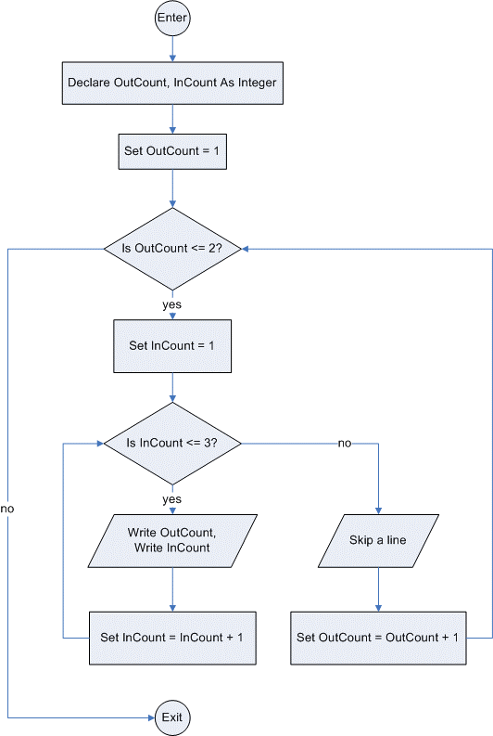
Flowchart for the nested loops on the previous slide

Slide 25
Nesting Other Kinds of Loops: Any style of loop may be nested. Each nested loop must be indented to indicate which statements are controlled by which looping construct.
Do
Code Statements
While <condition>
More code may be here
For (initial condition; test; increment)
more code here
End For
More code may be here
End While
More code may be here
While <condition>

Slide 26
Example: Drawing Squares
1 Declare Count1, Count2, Side As Integer
2 Declare Symbol As Character
3 Write “Choose a symbol (any character from the keyboard):“
4 Input Symbol
5 Write “Enter the length of a side of the square: “
6 Input Side
7 Set Count1 = 1
8 Set Count2 = 1
9 While Count1 <= Side
10 While Count2 <= Side
11 Print Symbol
12 Set Count2 = Count2 + 1
13 End While
14 Print <NL>
15 Set Count2 = 1
16 Set Count1 = Count1 + 1
17 End While

Slide 27
Mind Games Workout #1
X | Y | Z | output
1 | ? | ? | Pass Number 1
1 | 1 | 2 | 1 + 1 = 2
1 | 4 | 5 | 1 + 4 = 5
1 | 7 | 8 | 1 + 7 = 8
1 | 10 | 8
2 | 10 | 8 | Pass Number 2
2 | 1 | 3 | 2 + 1 = 3
2 | 4 | 6 | 2 + 4 = 6
2 | 7 | 9 | 2 + 7 = 9
2 | 10 | 9
3 | 10 | 9 | Pass Number 3
3 | 1 | 4 | 3 + 1 = 4
3 | 4 | 7 | 3 + 4 = 7
3 | 7 | 10 | 3 + 7 = 10
3 | 10 | 10
4 | 10 | 10
1 Declare X, Y, Z As Integer
2 For (X = 1; X < 4; X++)
3 Write “Pass Number “ + X
4 For (Y = 1; Y < 10; Y+3)
5 Set Z = X + Y
6 Write X + “ + “ + Y + “ = “+ Z
7 End For(Y)
8 End For(X)

Slide 28
Mind Games: Workout # 2
X | Y | Z | Count1 | Count2 | output
? | 3 | ? | 1 | ?
2 | 3 | ? | 1 | 1 | Pass Number 1
2 | 3 | 6 | 1 | 1 | X = 2, Y = 3, Z = 6
3 | 3 | 6 | 1 | 2
3 | 3 | 9 | 1 | 2 | X = 3, Y = 3, Z = 9
4 | 3 | 9 | 1 | 3
4 | 3 | 12 | 1 | 3 | X = 4, Y = 3, Z = 12
5 | 3 | 12 | 1 | 4
And so on...
Declare X, Y, Z As Integer
Declare Count1 As Integer
Declare Count2 As Integer
2 Set Y = 3
3 Set Count1 = 1
4 Do
5 Set X = Count1 + 1
6 Set Count2 = 1
7 Write “Pass Number “ + Count1
8 While Count2 <= Y
9 Set Z = Y * X
10 Write “X = “ + X + “, Y = “ + Y + “, Z = “ + Z
11 Set X = X + 1
12 Set Count2 = Count2 + 1
13 End While
14 Set Count1 = Count1 + 1
15 While Count1 < Y

Slide 29
1 Declare A, B, C As Integer
2 Set A = 1
3 Write “Cheers!”
4 While A < 3
5 Set C = A
6 Write A
7 Set B = 1
8 While B < 4
9 Set C = C + A
10 Write C
11 If (A == 1 AND C >= 4) Then
12 Write “Let’s do this some more!”
13 Else
14 If (A == 2 AND C >= 8) Then
15 Write “Who do we appreciate?”
16 End If
17 End If
18 Set B = B + 1
19 End While
20 Set A = A + 1
21 End While
Mind Games:
Workout #3

Slide 30
A | B | C | output
1 | ? | ? | Cheers!
1 | ? | 1 | 1
1 | 1 | 1
1 | 1 | 2 | 2
1 | 2 | 2
1 | 2 | 3 | 3
1 | 3 | 3
1 | 3 | 4 | 4
1 | 3 | 4 | Let’s do this some more!
1 | 4 | 4
2 | 1 | 2 | 2
2 | 1 | 4 | 4
2 | 2 | 4
2 | 2 | 6 | 6
2 | 3 | 6
2 | 3 | 8 | 8
2 | 3 | 8 | Who do we appreciate?
2 | 4 | 8
3 | 4 | 8
Mind Games:
Workout #3
Follow
Along…

